Slide 1

Analysis of recursive algorithms
Part 2

Slide 2

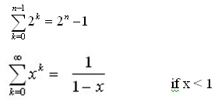



Solving Recurrence Relations - Iteration method
Steps:
Expand the recurrence
Express the expansion as a summation by plugging the recurrence back into itself until you see a pattern.
Evaluate the summation
In evaluating the summation one or more of the following summation formulae may be used:
Arithmetic series:
Geometric Series:
Special Cases of Geometric Series:

Slide 3

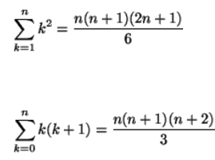
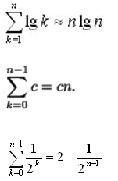
Solving Recurrence Relations - Iteration method (Cont’d)
Harmonic Series:
Others:

Slide 4
Analysis Of Recursive Factorial method
Example1: Form and solve the recurrence relation for the running time of factorial method and hence determine its big-O complexity:
T(0) = c (1)
T(n) = b + T(n - 1) (2)
= b + b + T(n - 2) by substituting T(n – 1) in (2)
= b +b +b + T(n - 3) by substituting T(n – 2) in (2)
…
= kb + T(n - k)
The base case is reached when n – k = 0 → k = n, we then have:
T(n) = nb + T(n - n)
= bn + T(0)
= bn + c
Therefore the method factorial is O(n)
long factorial (int n) {
if (n == 0)
return 1;
else
return n * factorial (n – 1);
}

Slide 5
Analysis Of Recursive Selection Sort
public static void selectionSort(int[] x) {
selectionSort(x, x.length - 1);
}
private static void selectionSort(int[] x, int n) {
int minPos;
if (n > 0) {
minPos = findMinPos(x, n);
swap(x, minPos, n);
selectionSort(x, n - 1);
}
}
private static int findMinPos (int[] x, int n) {
int k = n;
for(int i = 0; i < n; i++)
if(x[i] < x[k]) k = i;
return k;
}
private static void swap(int[] x, int minPos, int n) {
int temp=x[n]; x[n]=x[minPos]; x[minPos]=temp;
}

Slide 6
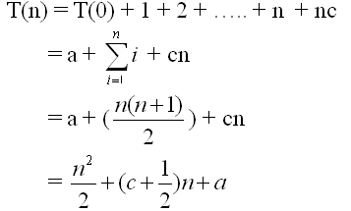
Analysis Of Recursive Selection Sort (Cont’d)
findMinPos is O(n), and swap is O(1), therefore the recurrence relation for the running time of the selectionSort method is:
T(0) = a (1)
T(n) = T(n – 1) + n + c if n > 0 (2)
= [T(n-2) +(n-1) + c] + n + c = T(n-2) + (n-1) + n + 2c by substituting T(n-1) in (2)
= [T(n-3) + (n-2) + c] +(n-1) + n + 2c= T(n-3) + (n-2) + (n-1) + n + 3c by substituting T(n-2) in (2)
= T(n-4) + (n-3) + (n-2) + (n-1) + n + 4c
= ……
= T(n-k) + (n-k + 1) + (n-k + 2) + …….+ n + kc
The base case is reached when n – k = 0 → k = n, we then have :
Therefore, Recursive Selection Sort is O(n²)

Slide 7
Analysis Of Recursive Binary Search
public int binarySearch (int target, int[] array,
int low, int high) {
if (low > high)
return -1;
else {
int middle = (low + high)/2;
if (array[middle] == target)
return middle;
else if(array[middle] < target)
return binarySearch(target, array, middle + 1, high);
else
return binarySearch(target, array, low, middle - 1);
}
}
The recurrence relation for the running time of the method is:
T(1) = a if n = 1 (one element array)
T(n) = T(n / 2) + b if n > 1

Slide 8
Analysis Of Recursive Binary Search (Cont’d)
Without loss of generality, assume n, the problem size, is a multiple of 2, i.e., n = 2^{k}
Expanding:
T(1) = a (1)
T(n) = T(n / 2) + b (2)
= [T(n / 2²) + b] + b = T (n / 2²) + 2b by substituting T(n/2) in (2)
= [T(n / 2³) + b] + 2b = T(n / 2³) + 3b by substituting T(n/2²) in (2)
= ……..
= T( n / 2^{k}) + kb
The base case is reached when n / 2^{k} = 1 ➔ n = 2^{k} ➔ k = log₂ n, we then
have:
T(n) = T(1) + b log₂ n
= a + b log₂ n
Therefore, Recursive Binary Search is O(log n)

Slide 9
Recursion-Tree Method
Recursion tree: visual representation of recursive call hierarchy
Recursion Tree is another method for solving the recurrence relations.
A recursion tree is a tree where each node represents the cost of a certain recursive sub-problem.
We sum up the values in each node to get the cost of the entire algorithm.

Slide 10

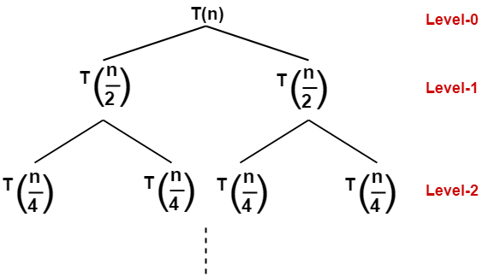
Example 1 Recursion tree method
Solve the following recurrence relation using recursion tree method-
T(n) = 2T(n/2) + n
Step-01:
Draw a recursion tree based on the given recurrence relation.
The given recurrence relation shows-
A problem of size n will get divided into 2 sub-problems of size n/2.
Then, each sub-problem of size n/2 will get divided into 2 sub-problems of size n/4 and so on.
At the bottom most layer, the size of sub-problems will reduce to 1.

Slide 11
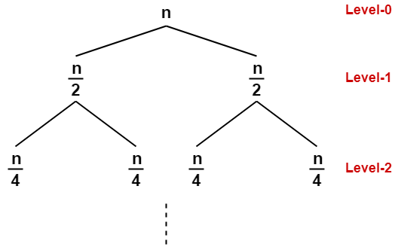
Example 1 Recursion tree method
The given recurrence relation shows-
The cost of dividing a problem of size n into its 2 sub-problems and then combining its solution is n.
The cost of dividing a problem of size n/2 into its 2 sub-problems and then combining its solution is n/2 and so on.

Slide 12
Example 1 Recursion tree method
Step-02:
Determine cost of each level-
Cost of level-0 = n
Cost of level-1 = n/2 + n/2 = n
Cost of level-2 = n/4 + n/4 + n/4 + n/4 = n and so on.
Step-03:
Determine total number of levels in the recursion tree-
Size of sub-problem at level-0 = n/2⁰
Size of sub-problem at level-1 = n/2¹
Size of sub-problem at level-2 = n/2²
Continuing in similar manner, we have-
Size of sub-problem at level-i = n/2^{i}
Suppose at level-x (last level), size of sub-problem becomes 1. Then-
n / 2^{x} = 1
2^{x} = n
Taking log on both sides, we get-xlog2 = logn
x = log₂n
∴ Total number of levels in the recursion tree = log₂n + 1

Slide 13

Example 1 Recursion tree method
Step-04:
Determine number of nodes in the last level-
Level-0 has 2^0 nodes i.e. 1 node
Level-1 has 2^1 nodes i.e. 2 nodes
Level-2 has 2^2 nodes i.e. 4 nodes
Continuing in similar manner, we have-
Level-log2n has 2^log2n nodes i.e. n nodes
Step-05:
Determine cost of last level-
Cost of last level = n x T(1) = θ(n)
Step-06:
Add costs of all the levels of the recursion tree and simplify the expression so obtained in terms of asymptotic notation-
= n x log2n + θ (n)
= nlog2n + θ (n)
= θ (nlog2n)

Slide 14
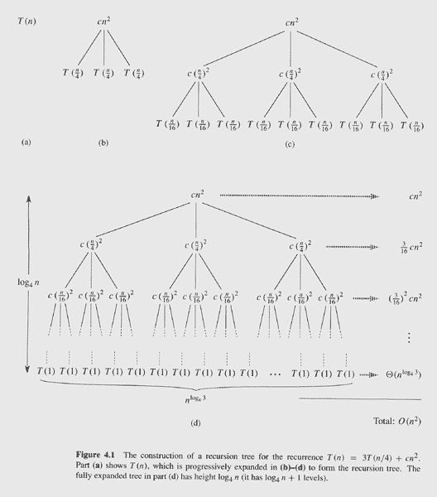
Example 2
T(n) =
3T(⎣n/4⎦) + Θ(n²)

Slide 15
Example 2 Recursion-Tree Method
T(n) =
3T(⎣n/4⎦) + Θ(n²)

Slide 16
Example 2 Recursion-Tree Method
T(n) =
3T(⎣n/4⎦) + Θ(n²)

Slide 17
Example 2 Recursion-Tree Method
T(n) =
3T(⎣n/4⎦) + Θ(n²)

Slide 18
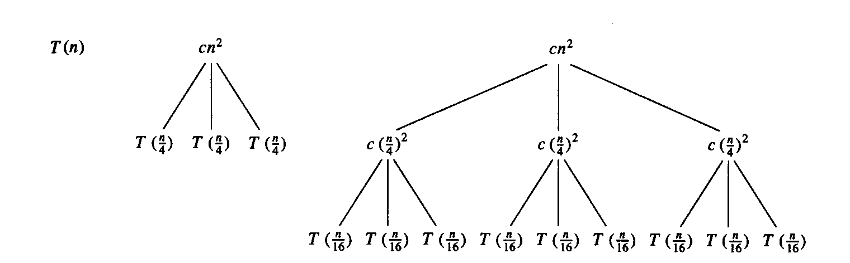
Example 2 Explanation
E.g.: T(n) = 3T(n/4) + cn²
Subproblem size at level i is: n/4^{i}
Subproblem size hits 1 when 1 = n/4^{i} ⇒ i = log₄n
Cost of a node at level i = c(n/4^{i})²
Number of nodes at level i = 3^{i} ⇒ last level has 3^{log}₄^{n} = n^{log}₄³ nodes
Total cost:
⇒ T(n) = O(n²)

Slide 19
Example 2 Recursion-Tree Method
Gathering all the costs together:
log₄n−1
T(n) =
Σ
(3/16)^{i}cn² + Θ(n^{log43})
i=0
∞
T(n) ≤
Σ
(3/16)^{i}cn² + o(n)
i=0
T(n) ≤
(1/(1−3/16))cn² + o(n)
T(n) ≤
(16/13)cn² + o(n)
T(n) =
O(n²)

Slide 20
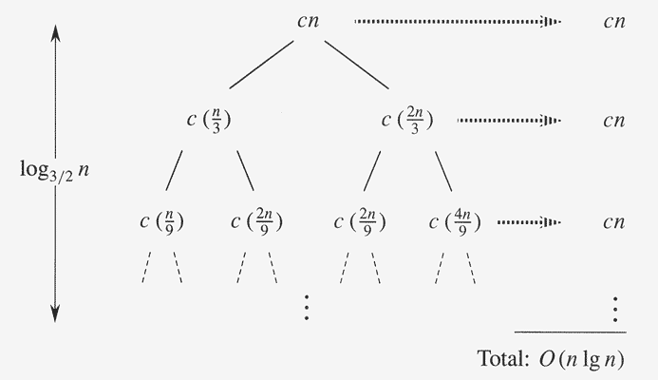
Example 3 Recursion-Tree Method
T(n) =
T(n/3) + T(2n/3) + O(n)

Slide 21
Example 3 Recursion-Tree Method
An overestimate of the total cost:
log_{3/2}n−1
T(n) =
Σ
cn + Θ(n^{log3/22})
i=0
Counter-indications:
T(n) =
O(n lg n) + ω(n lg n)
Notwithstanding this, use as “guess”:
T(n) =
O(n lg n)

